Slide 1
Impact of Windows Size in windowed aggregations
Mentor Jeyhun Karimov
Work group Andres Vivanco – Patrick Lehmann

Slide 2
Agenda
Group presentation - Objectives
Individual presentation
Approach 1 - Andres
Approach 2 - Patrick

Slide 3




Objectives
Group presentation
This project aims to analyze the impact of window size to latency with different streaming systems:
Experiments are expected to conduct with different
cluster size
Workload (input data speed)
window length and slide
window types: partitioned and non-partitioned
batch size (for Spark and Trident).
Seite 3

Slide 4
Agenda
Group presentation - Objectives
Individual presentation
Approach 1 - Andres
Approach 2 - Patrick

Slide 5
Agenda – Approach 1
Benchmarking Design / Methodology
Datasets
Data Generator
Experiments
cluster size
Workload (input data speed)
window length and slide
window types: partitioned and non-partitioned
batch size (for Spark and Trident).
Analysis of results
Conclusions

Slide 6
Benchmarking Design

Slide 7
Agenda – Approach 1
Benchmarking Design / Methodology
Datasets
Data Generator
Experiments
cluster size
Workload (input data speed)
window length and slide
window types: partitioned and non-partitioned
batch size (for Spark and Trident).
Analysis of results
Conclusions

Slide 8
Experiments

Slide 9
Agenda – Approach 1
Benchmarking Design / Methodology
Datasets
Data Generator
Experiments
cluster size
Workload (input data speed)
window length and slide
window types: partitioned and non-partitioned
batch size (for Spark and Trident).
Analysis of results
Conclusions

Slide 10
Agenda
Group presentation - Objectives
Individual presentation
Approach 1 - Andres
Approach 2 - Patrick

Slide 11
Agenda – Approach 2
Benchmarking Design / Methodology
Datasets
Data Generator
Experiments
cluster size
Workload (input data speed)
window length and slide
window types: partitioned and non-partitioned
batch size (for Spark and Trident).
Analysis of results
Conclusions

Slide 12
Benchmarking Design
Compare Flink and Spark
Large TaxiRide file for the datastream
Kafka to generate the datastream
Average number of passengers as aggregation
Maximum timestamp in each window to measure latency

Slide 13
Benchmarking Design
1 Master node
5 Worker node
1 Zookeeper node
1 Kafka node
1 Producer node
Change 1 parameter at time:
Windowsize
Slidingsize
Workload

Slide 14
Benchmarking Design
conf.ini
Data file
Kafka
Flink/Spark
Output
Timestamp
Timestamp
Latency

Slide 15
Agenda – Approach 2
Benchmarking Design / Methodology
Datasets
Data Generator
Experiments
Workload (input data speed)
Windowsize
Slidingsize
Analysis of results
Conclusions

Slide 16
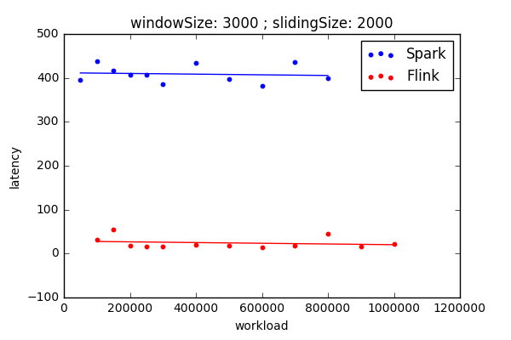
Experiments - Workload

Slide 17
Experiments - Backpressuring
When: System is receiving data at a higher rate than it can process
What: Reduces receiving rate
Why: So no delay in computation occurs
Result: Latency stays approximately constant

Slide 18
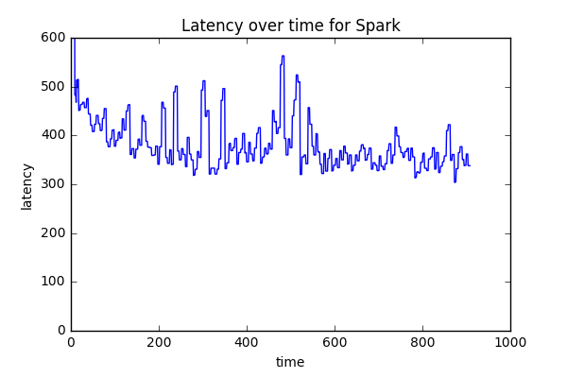
Experiments - Backpressuring

Slide 19
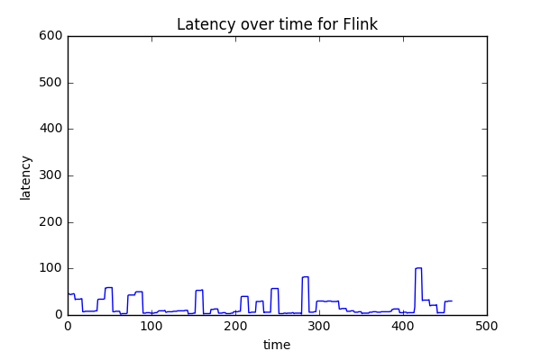
Experiments - Backpressuring

Slide 20
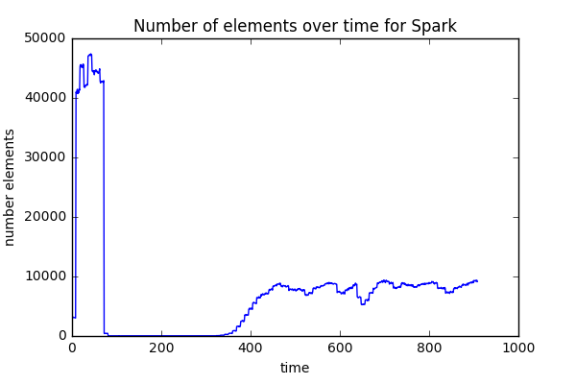
Experiments - Backpressuring

Slide 21
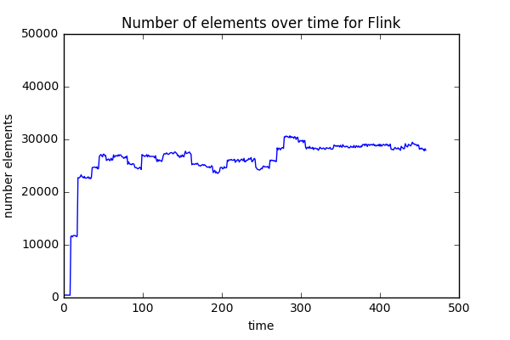
Experiments - Backpressuring

Slide 22
Experiments - Workload

Slide 23
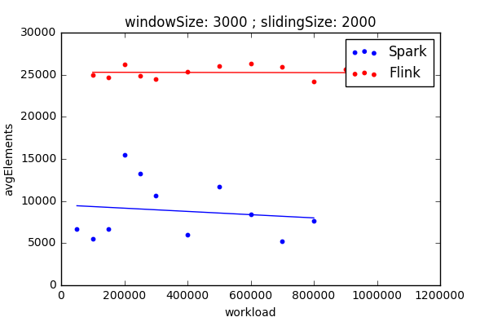
Experiments - Workload

Slide 24
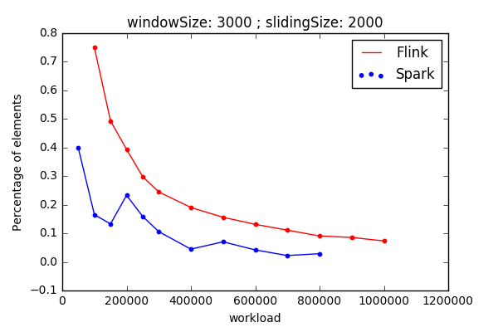
Experiments - Workload

Slide 25
Experiments - Workload
With higher workload the backpressuring is enabled
Therefore the latency stays constant
But: The throughput rate decreases with higher workload
→ Latency – Throughput Trade-off

Slide 26
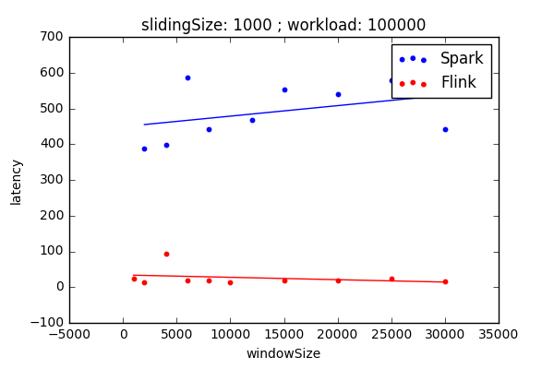
Experiments - Windowsize

Slide 27
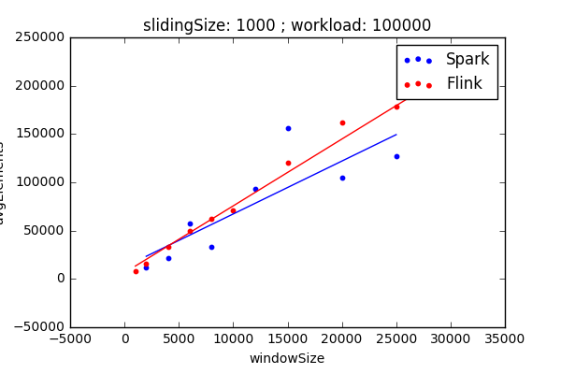
Experiments - Windowsize

Slide 28
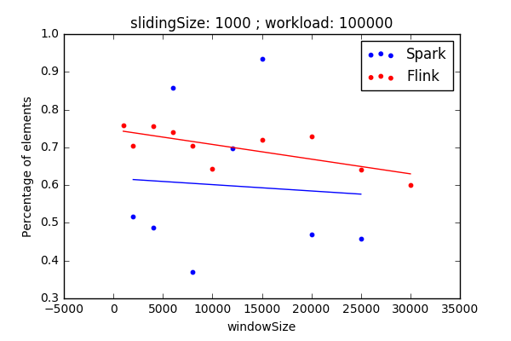
Experiments - Windowsize

Slide 29
Experiments - Windowsize
3 second window with 1 second slidingtime
5 second window with 1 second slidingtime
Just 1 new block
Just 1 new block

Slide 30
Experiments - Windowsize
Windowsize does not influence the latency or throughput rate
Explanation:
With higher windowsize the number of new elements stays constant

Slide 31
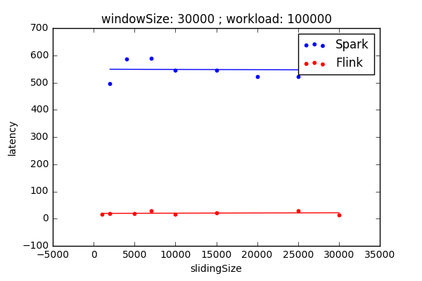
Experiments - Slidingsize

Slide 32
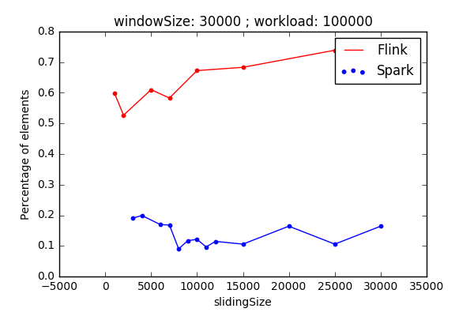
Experiments - Slidingsize

Slide 33
Experiments - Slidingsize
4 second window with 1 second slidingtime
4 second window with 2 second slidingtime
Just 1 new block
2 new blocks
But: doubled time for computation

Slide 34
Experiments - Slidingsize

Slide 35
Agenda – Approach 2
Benchmarking Design / Methodology
Datasets
Data Generator
Experiments
cluster size
Workload (input data speed)
window length and slide
window types: partitioned and non-partitioned
batch size (for Spark and Trident).
Analysis of results
Conclusions

Slide 36
Conclusion
Backpressuring fixes latency
Latency-Throughput Trade-off
Workload: Decreases Throughput rate
Window- and Slidingsize have no significant influence
In General: Flink outperforms Spark
But: More experiments needed for sufficient results

Slide 37
Thank you for your attention
Seite 37

